Slide 1
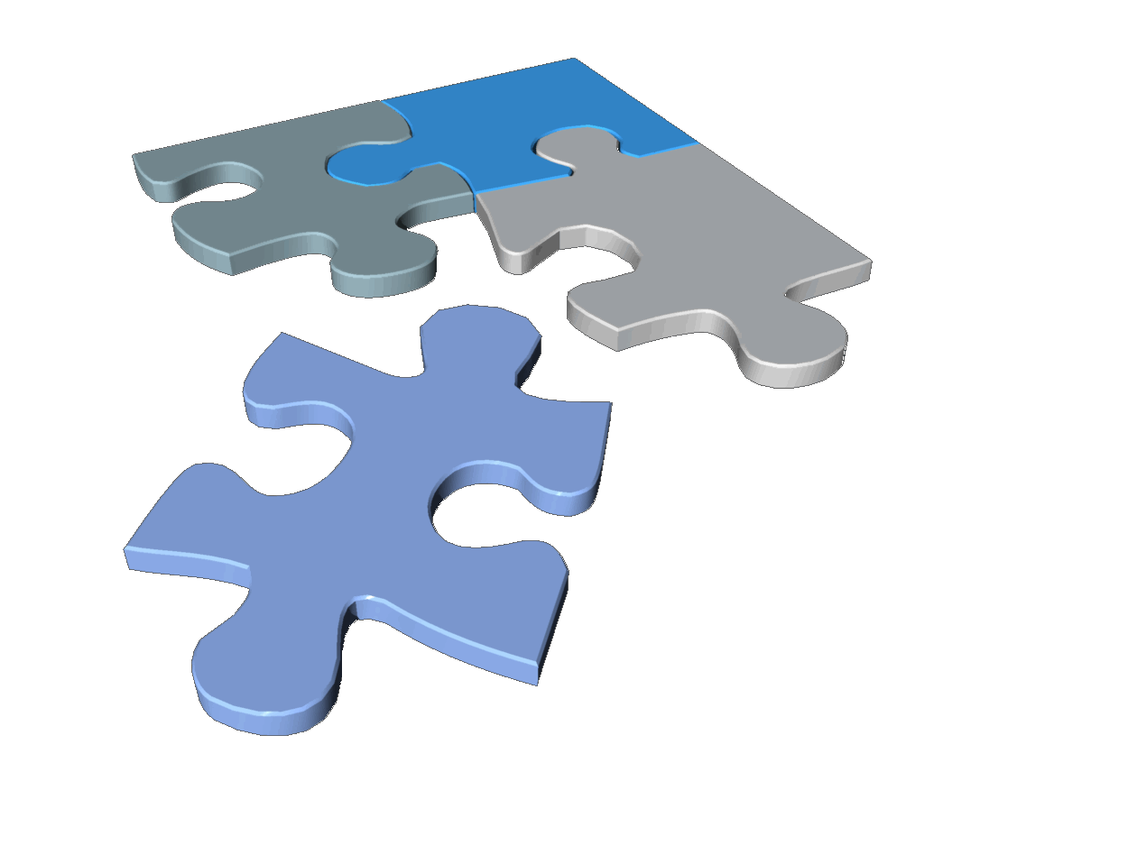
Solving the Puzzle of Maintenance in Hospitality
Delivering the ultimate guest satisfaction by improving staff efficiency and accountability
SynergyMMS
®
Maintenance Management System
Notes:
This presentation addresses the service-aspect of maintenance. We are often so busy trying to provide excellent guest service that we miss the value of effective maintenance. Guest complaints are something everybody has and nobody wants. You can, however, reduce guest complaints by 30% or more with SynergyMMS. With that in mind, an effective maintenance program is worth a closer look.

Slide 2
Hospitality maintenance is like a puzzle.
Solving that puzzle is the key to guest satisfaction and loyalty.
Notes:
Hospitality maintenance is like a puzzle. The complexity of that puzzle depends on the environment in each property, the local market, and the economy. Often, maintenance is postponed or skipped due to limited resources, but this only delays problems which are likely to become much more severe. But maintenance isn’t just fixing things, how well you maintain a property will have an impact on guest loyalty. All hotels have beds, televisions and marble-top sinks. What sets you apart is your service and the quality of the property. The effort put forth in preserving the asset and equipment will reflect in the guest satisfaction scores and the bottom line.

Slide 3
Effective maintenance requires coordination between many departments.
Front Desk/PBX
Management
Housekeeping
Engineering
To understand the challenges, you have to know the people involved.
Notes:
Hospitality maintenance is no easy task as it requires coordination between departments and flexibility around occupancy. Limited staffing can make it difficult to complete scheduled maintenance since so much effort is placed on putting out fires. The problems are the same everywhere and the economy has not helped matters at all. To better appreciate the situation, it is worth examining the challenges of the individual departments.

Slide 4
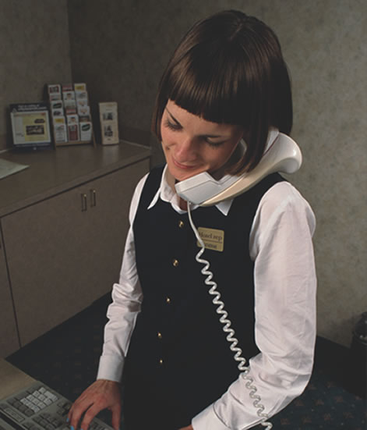
Front Desk/PBX
Challenges:
High call volumes
Limited staffing
Receive and dispatch calls
Must record issues quickly
Do not have Engineering background
Notes:
These folks are constantly on the phone and often the nerve center for calls. They are a primary point of contact for the guests and have only a few seconds to accurately record issues.

Slide 5
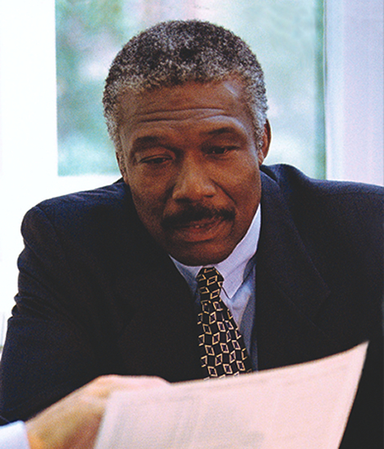
Management
Challenges:
Coordinate multiple departments
Justify staffing/budgets
Need real-time status
Guest follow up
Data mining/trend analysis
Notes:
Management needs information in order to make decisions. They need real-time data and historical data that is easy to understand and makes sense and they need it now.

Slide 6
Housekeeping
Challenges:
Primary eyes and ears
Technically challenged (not Engineers)
No access to computers
Language barriers
Notes:
Housekeepers are the eyes and ears of the property. They are constantly in the rooms and often are the primary means of discovering issues. They are also the least technical, do not typically have access to computers and may not speak English as their first language.

Slide 7
Engineering
Challenges:
Limited staffing
Mobile
Delays in receiving work
Occupancy limits access
Notes:
An Engineer’s time is best spent fixing something not riding elevators. They need their information on the move and also require constant, yet discreet, communication.

Slide 8
Summary of department challenges:
Front Desk doesn’t have time
Housekeepers may not speak English as a first language or use computers
Engineers are never at their desk
Management needs information NOW!
Does that sound about right?
Notes:
Taking the challenges of the departments into consideration, Front Desk doesn’t have time, Housekeepers don’t speak English or use computers, Engineers are never at their desk and Management needs information NOW! Does that sound about right?

Slide 9
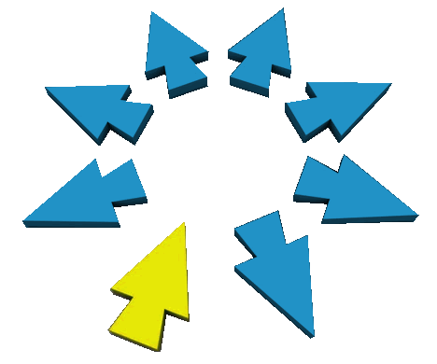
SynergyMMS facilitates workflow
Fast & easy data entry
Immediate distribution
Real-time status visibility
Automatic dispatching
Multilingual interface
Load balancing
Unlimited users
Enterprise support
Notes:
All of the issues identified on the previous slides are handled with SynergyMMS. The feature set and multiple interfaces are designed to reach individuals where they are comfortable and effective. Entering data is extremely fast and easy. Multilingual interfaces support staff members needs. Mobile tools and messaging keeps mobile personnel in touch while on the move and automated report delivery provide the information needed in real-time.

Slide 10
SynergyMMS offers a complete suite of helpful and intuitive tools
Room/Equipment Preventive Maintenance
Unplanned Maintenance Requests
Guest Requests
Intelligent Dispatching
Mobile Application
Comprehensive Reports
Notes:
Our complete suite is entirely scalable to support a property with 80 rooms or 3,000. Our deployment and support methods respect the most stringent IT requirements of our many customers both in the U.S. and in other countries.

Slide 11
Why SynergyMMS?
In an independent study comparing SynergyMMS and 6 other leading CMMS solutions, SynergyMMS was selected as the best product based on three critical criteria:
Ease of use
Feature Set
Price
Notes:
There are lots of products that claim to manage maintenance so how is ours any different, you may ask. In a recent independent study SynergyMMS was compared with 6 other leading competitors and SynergyMMS was selected as the best choice based on ease of use, feature set and price – in that order.
We have spent the last 30 years in business specializing in a single vertical – hospitality. Our intimate understanding of hospitality operations and our appreciation for the unique levels of involvement among the different departments and personnel sets us apart.

Slide 12
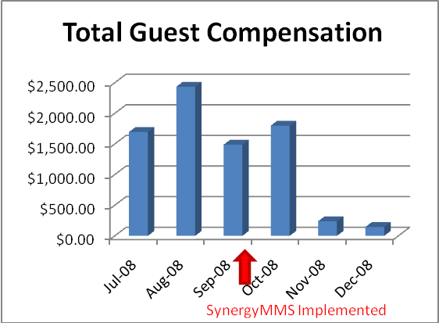
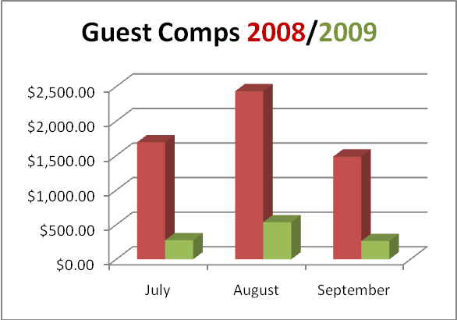
SynergyMMS delivers results
A case study reveals an immediate reduction of guest complaints and related guest compensation.
Guest Complaints -30%
Guest Compensation - $1,500/month!
A year later, the results are still impressive!
Notes:
If you are still looking for a good reason to justify an effective maintenance program, here you go. This is a case study illustrating some of the financial benefits of SynergyMMS. You can see that just after the program was implemented and guest compensation fell almost to zero. Guest complaints also dropped by an amazing 30%! As we all know, guest compensation is how we make up for a troubled stay and it comes right off of the bottom line. You can also see that a year later, the property is going strong saving an average $1,500 per month in guest comps with SynergyMMS.

Slide 13
The choice in Hospitality for solving the puzzle of guest satisfaction, employee efficiency and accountability.
Front Desk/PBX Management Housekeeping Engineering
SynergyMMS
®
Maintenance Management System
Copyright © Systems Associates, Inc. 2012
Notes:
In summary, a comprehensive maintenance program will save you money and improve the quality of the guest’s experience. It will also result in an increase in staff efficiency and accountability. You don’t have to manage maintenance, but if you don’t, it will manage you.
Thank you.

